Slide 1


New Haven Development Commission
July 12, 2023
CITY OF NEW HAVEN JUSTIN ELICKER, MAYOR BOARD OF ALDERS

Slide 2
Agenda
Welcome
Approval of Minutes
State & George St DECD Challenge Grant / RFP Updates
Economic Development Updates
Questions/Discussions

Slide 3



State & George DECD Challenge Grant /
RFP Updates

Slide 4
State and George St

Slide 5
State & George St

Slide 6
Economic Development Updates
Economic Development Administration

Slide 7




An American Rescue Plan for our Community
Youth Engagement & Early Childhood
Wealth
Creation & Economy
Vocational & Technical Initiative
Climate Emergency
I’m Home
Initiative

Slide 8
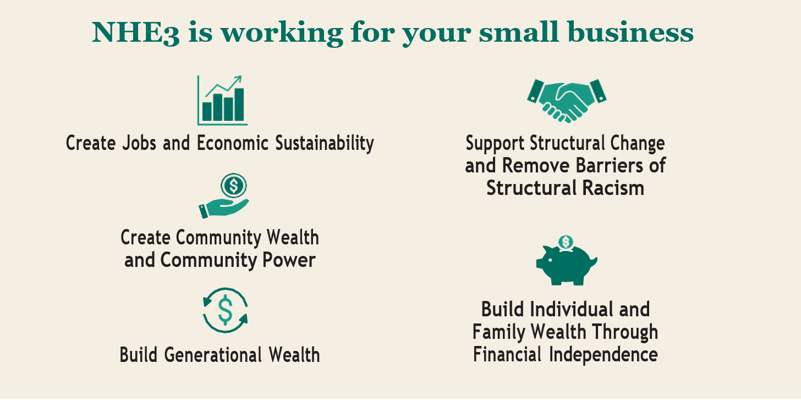
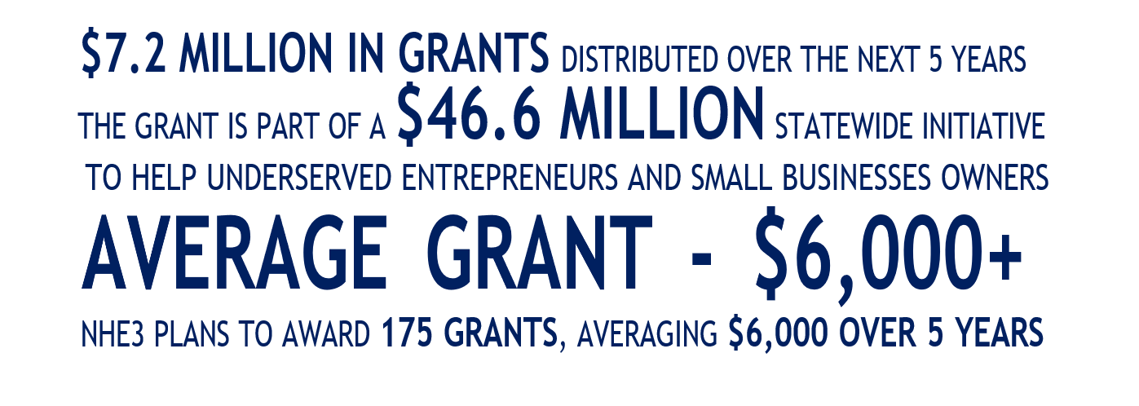

New Haven Equitable Entrepreneurial Ecosystem (NHE3)
NHE3’s Entrepreneurial Support Organizations (ESOs) provide
Connections to capital
Technical assistance
Capacity-building resources
Entrepreneurs benefit from business advisory and support services
Webinars & Workshops
Education & Training
Mentoring & Coaching
Entrepreneurial Wellness & Access to Business Financing
Questions or Comments:
Cathy Graves [crgraves@newhavenct.gov]

Slide 9

Economic Development Updates
The City's NEOC grant has been released to fund economic development activities. Accepting applications until July 25th.
Visit Bonfire
Eligible projects:
Public Space/Realm Improvements
Small Business Costs
Special Events
Real Estate Development

Slide 10
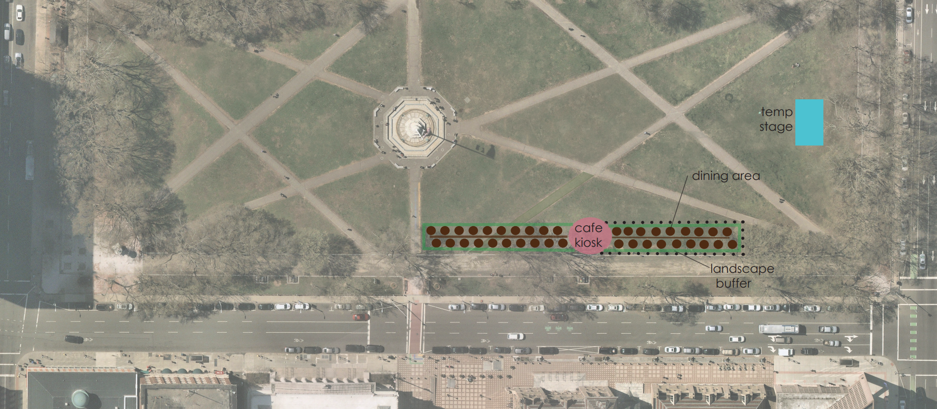
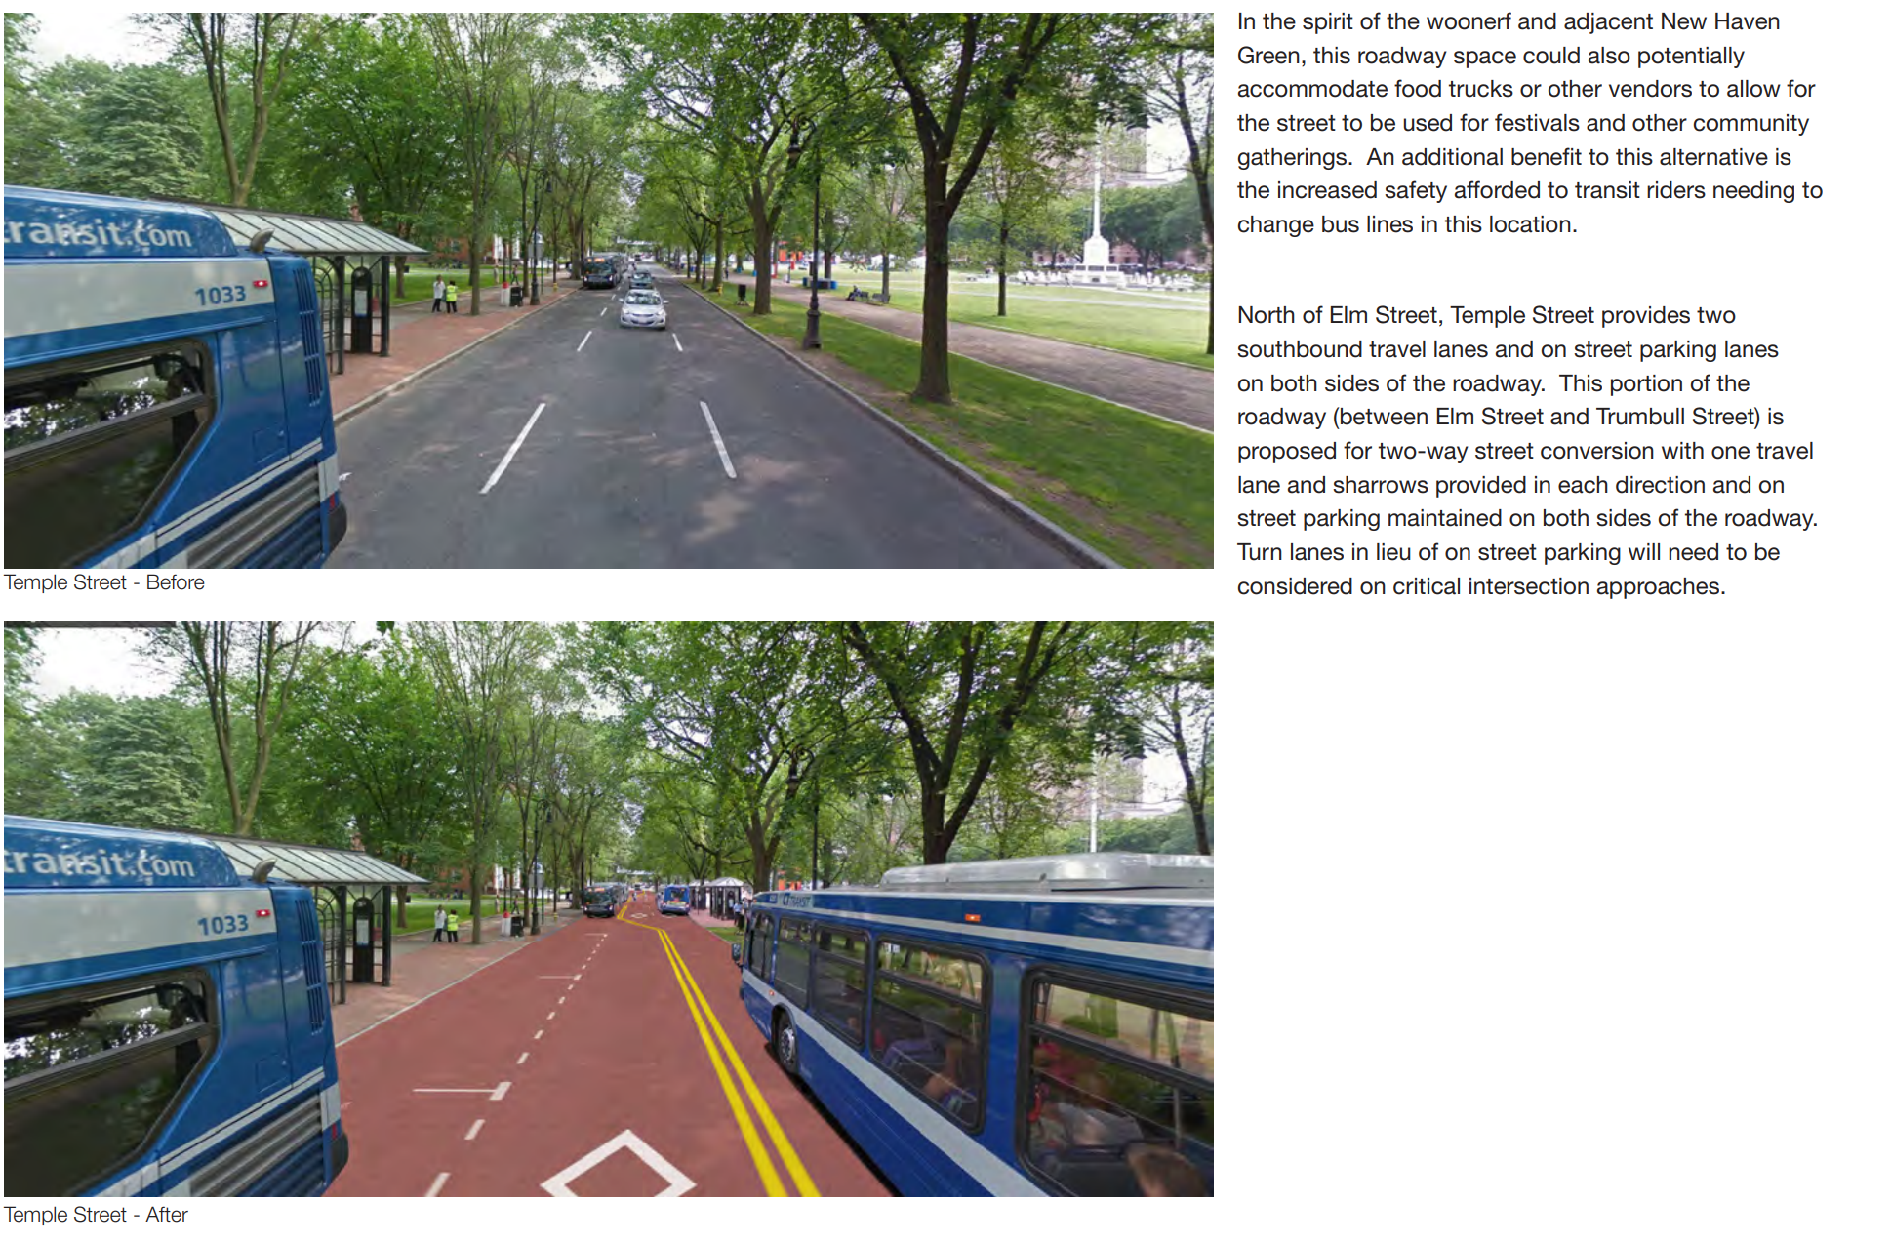
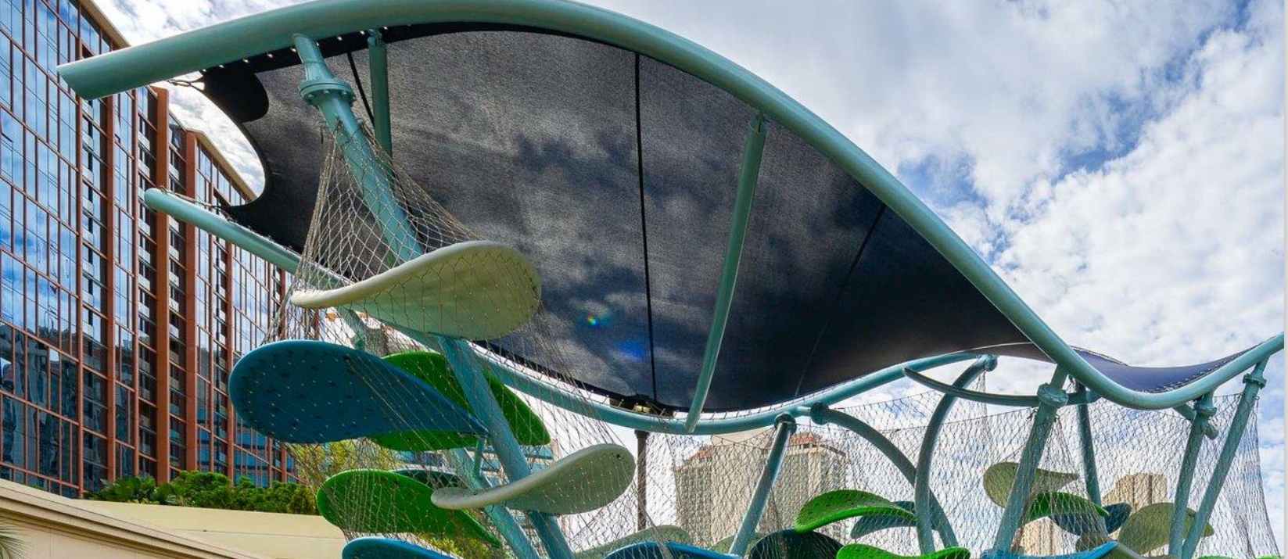
Downtown For All
The City applied to Community Investment Fund (Round 3):
New Haven Green: With $2.2M for Project 1, activation of the New Haven Green to include bathrooms and a Café kiosk to restore public dignity and to purchase affordable sundries close to transportation hubs
Roadway & Two-Way Conversion: With $5M for Project 2, installation of streetscape and roadway improvements, like repurposing Temple Street into an “Woofner,” converting the one-way into a two-way, raising the intersection, and installing other streetscape improvements to the corridor, all of which reduce travel speeds, calm traffic, and increase the visibility of bicyclists and pedestrian visibility.
Family Playground: With $1.5M for Project 3, revitalization of an underutilized, deteriorating plaza into a family park to spur recreation, memory creation, and access to green, open space.

Slide 11
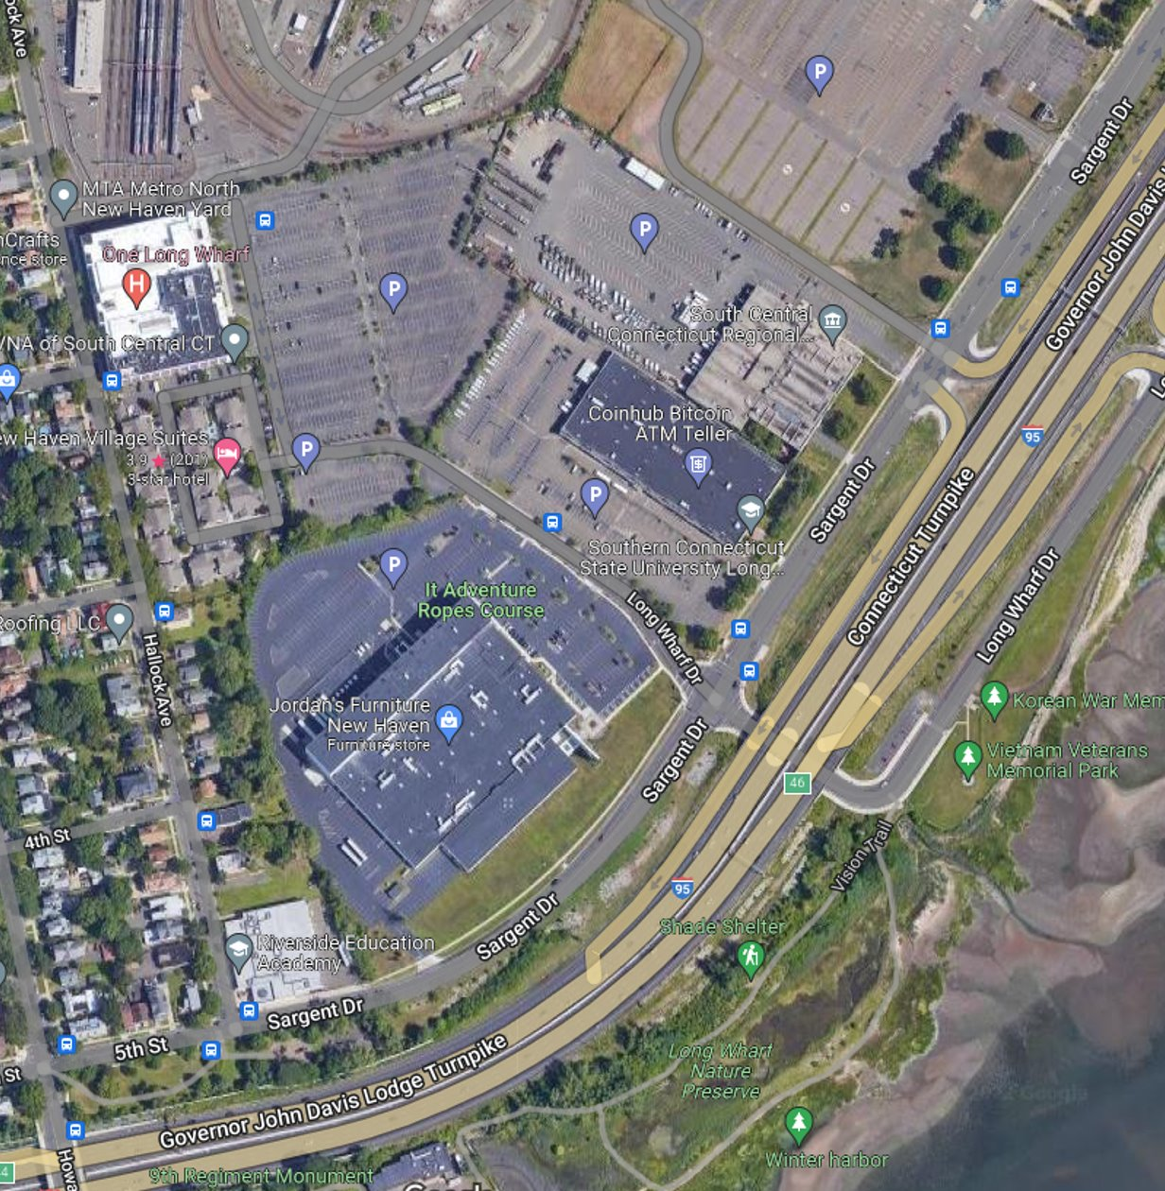
Long Wharf Demolition
The City applied to Community Investment Fund (Round 3):
Demolition & Site Predevelopment: With $3M for Site Prep & Readiness, demolish the old Gateway Community College Building (in red). Remediate the site and build infrastructure that maintains dry egress.
Investment: $3.0 M
Benefits:
New construction - educational use
Create direct jobs and employment pathways through vocational/community college education.
Increase coastal inland resiliency
Advance recommendations of POCD and Long Wharf Responsible Growth Plan

Slide 12
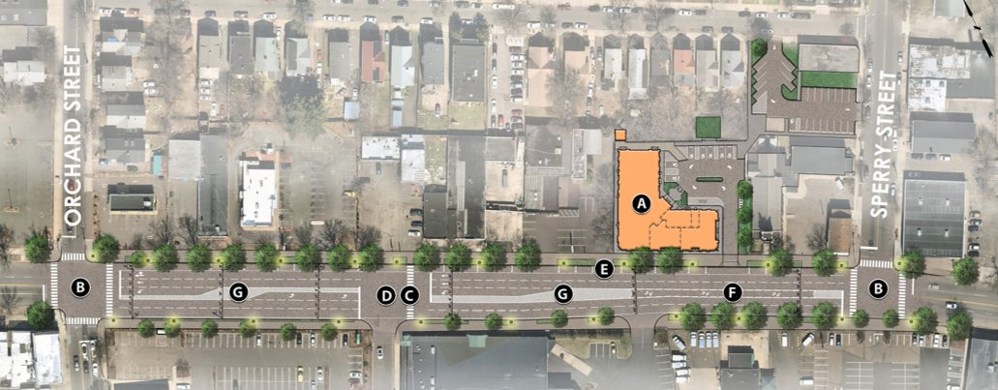
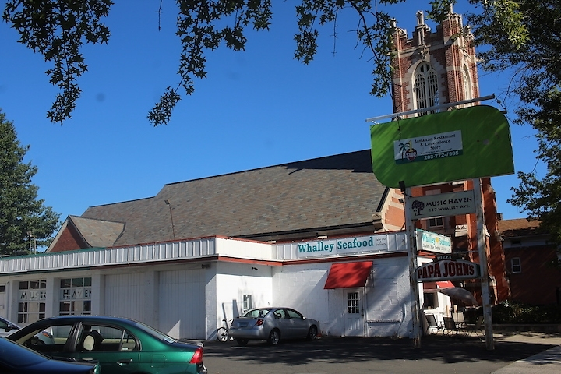
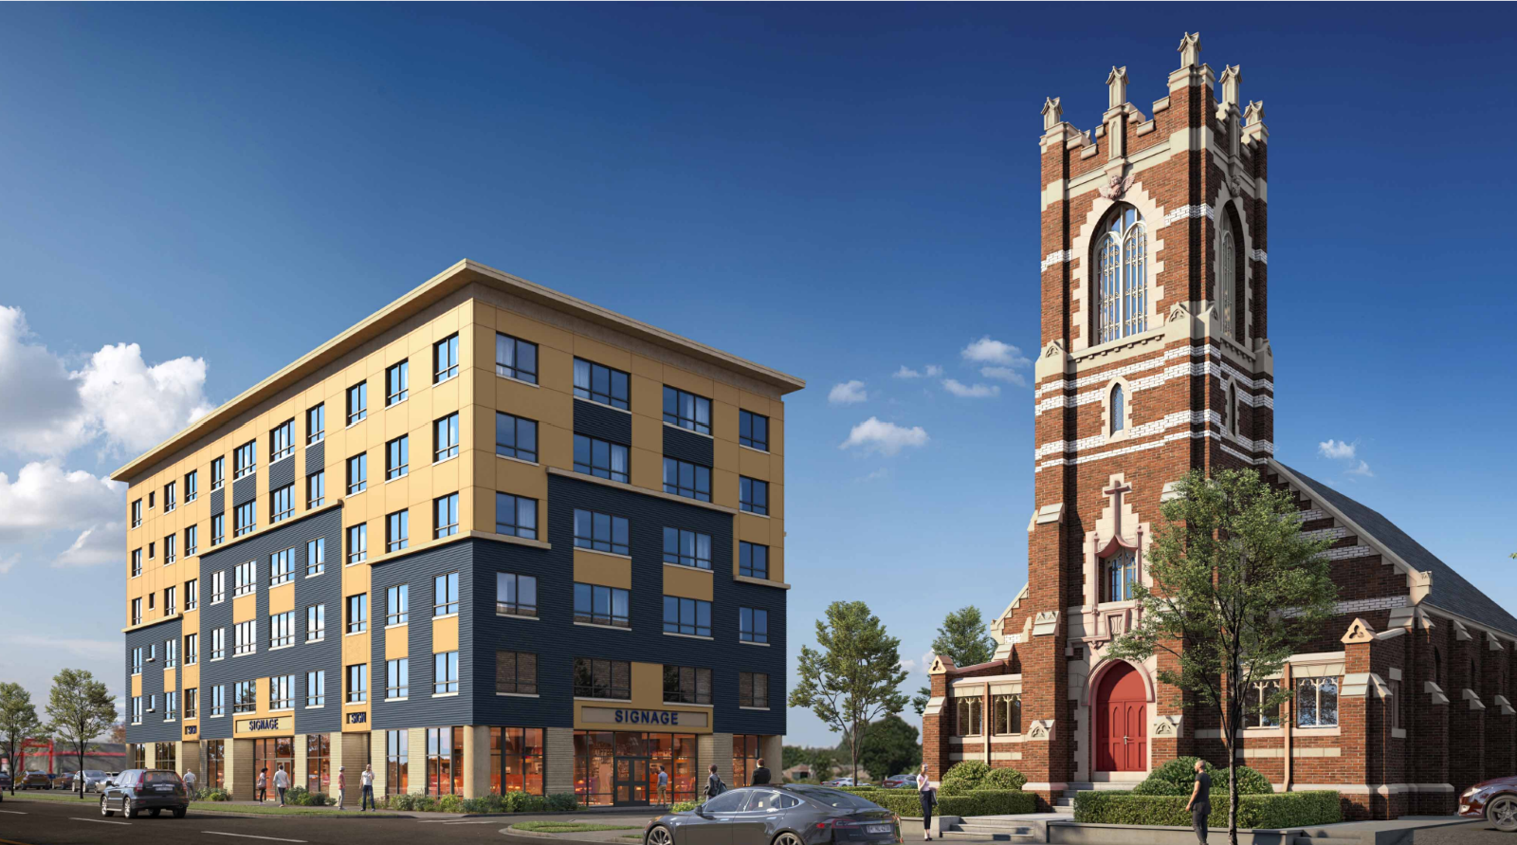
Whalley Avenue
The City applied to Community Investment Fund (Round 3):
Roadway & Infrastructure: With $1.5M for Project 1, restripe Whalley Ave. from Howe to Ella Grasso, while installing critical intersection and roadway improvements to calm traffic and increase pedestrian and cyclist visibility.
Streetscape Improvements: With $750k for Project 2, install and upgrade sidewalks, curbs, street furniture, lighting, green infrastructure, small businesses' exterior facades, and other permanent improvements to entryway corridors in commercial districts.
St. Luke Project: With $6M for Project 3, transform deteriorating buildings and underutilized lots into a public amenity for the provision of an 89% affordable 55-unit housing complex (30-80% AMI) with retail on the ground level.

Slide 13


Economic Development Updates
Southern Connecticut State University applied for EDA's STEM Talent Challenge Grant –
Partnership with the City and Winstanley on 101 College Street Classroom

Slide 14

City of New Haven Brownfield Awards
AWARDED JUNE 22, 2023!
112 Chapel St: $804,485 grant to remediate the 0.6-acre property to serve as a parking and loading area for a new 10,000 square foot warehouse for Art to Frames, a manufacturing company that produces framing and a variety of home improvement decorative products.
156 Dixwell Ave: $4,000,000 grant to complete demolition, abatement, and remediation of the 7.6-acre site to enable the redevelopment of ConnCAT Place headquarters, Hill Health Center clinic, a daycare facility, 184 rental housing units (20% affordable), an office building, townhomes, and a 19,855 square foot performing arts center.
135 Fulton Terr: $207,900 grant for cleanup activities on the 0.55-acre property to enable a new 28,000 square foot, pre-engineered warehouse building.
34 Level St: $999,999 loan for abatement and remediation of the 5.97-acre former nursing home facility to be redeveloped into a 50-unit, elderly supportive housing development.

Slide 15

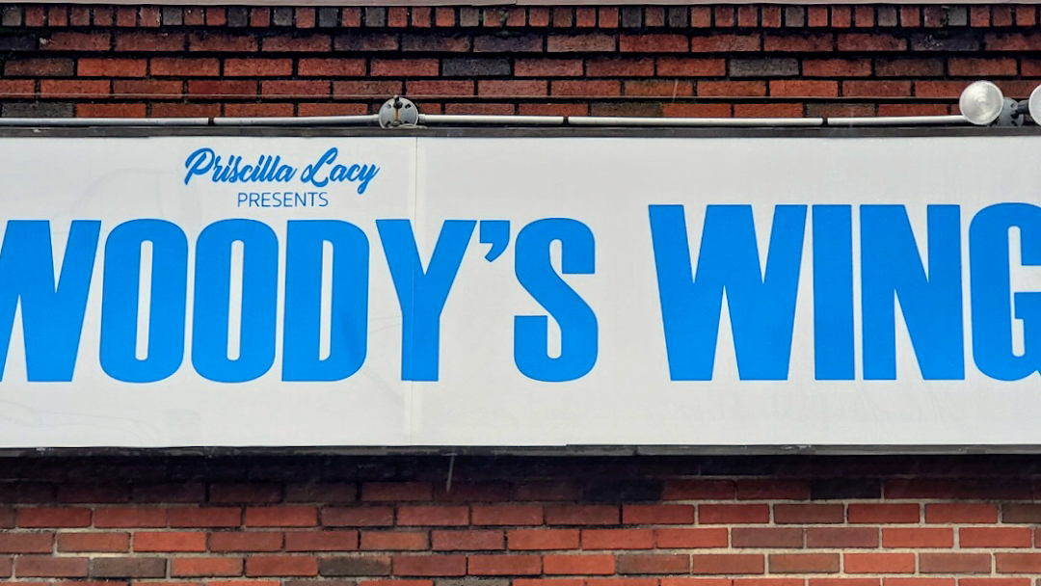
Celebrating Small Business!
Mi Gusto
(Thurs 7/20)
Woody's Wings
(Thurs 7/13)

Slide 16

Thank You / Discussion
CITY OF NEW HAVEN
JUSTIN ELICKER, MAYOR
BOARD OF ALDERS

